Slide 1
VIBRATIONS OF FACIAL TISSUES DURING PHONATION IN “RESONANT” AND “NON-RESONANT”
VOICE QUALITY
Jaromír Horáček , Vojtěch Radolf
Institute of Thermomechanics of the Czech Academy of Sciences,
Prague, Czech Republic
Jan G. Švec
Palacký University Olomouc
Anne-Maria Laukkanen
Tampere University, Finland

Slide 2
Introduction
So-called “resonant voice” is an important goal in voice training and therapy and causes sensations of vibrations on the facial area (Verdolini et al., 1998; Smith et al., 2005).
Acoustically, it has been found to imply tuning of the first vocal tract resonance to the lowest voice harmonics (Barrichelo-Lindström & Behlau, 2009).
Physiologically, resonant voice is produced with barely adducted vocal folds (Verdolini et al., 1998) and with larger glottal flow amplitude and stronger first partial (Sundberg, 2022).
According to modelling (Zhang, 2020), resonant voice reduces impact stress posed on the vocal fold tissue.
Barrichelo-Lindström,V. and Behlau, M. (2009) Resonant voice in acting students: perceptual and acoustic correlates of the trained y-buzz by Lessac. Journal of Voice, 23, 5, pp. 603-609.
Smith, CG., Finnegan, EM. and Karnell, MP. (2005) Resonant voice: spectral and nasoendoscopic analysis. Journal of Voice, 19, 4, pp. 607–622.
Sundberg, J. (2022) Objective characterization of phonation type using amplitude of flow glottogram pulse and of voice source fundamental. Journal of Voice 36, 1, pp. 4-14.
Verdolini, K., Druker, DG., Palmer, PM. and Samawi, H. (1998) Laryngeal adduction in resonant voice. Journal of Voice 12, 3, pp. 315-327.
Zhang, Z. (2020) Laryngeal strategies to minimize vocal fold contact pressure and their effect on voice production. J Acoust Soc Am, 148, 2, pp. 1039–1050.

Slide 3
Earlier studies of facial vibrations
It was observed that facial vibrations are vowel dependent. Forehead, cheek and lower mandible were found to resonate most for closed vowels /i, u/, and less for open vowel /a/. The strongest acoustic component in voice is typically the partial nearest the first formant (F1) (Kirikae et al., 1964).
Skull resonates at high frequencies, the lowest resonance frequencies being around 972 Hz and 1230 Hz according to Håkansson et al. (1993).
The lowest resonance frequency of human skull in vitro was found around 1100 Hz, when the soft brain tissue was substituted by a gelatine, and the most sensitive place to the vibration excitation of the skull was found at the edge of hard palate, behind the front teeth (Horáček et al. 2004).
Kirikae, J., Sato, T., Oshima, H. and Nomoto, K. (1964) Vibration of the body during phonation of vowels. Rev. de Laryngologie, Otologie, Rhinologie 85, pp. 317-345.
Håkansson, B., Brandt, A., Carlsson, P. and Tjellström, A. (1994) Resonance frequencies of the human skull in vivo. The Journal of the Acoustical Society of America, 95, 3, pp. 1474-1481.
Horáček, J., Veselý, J., Pešek, L. and Vohradník, M. (2004) Fundamental dynamic characteristics of human skull. Engineering Mechanics, 11, 2, pp. 139 –158.

Slide 4
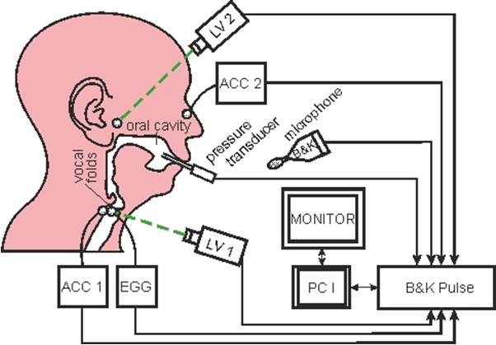
Schema of the measurement
Measurements of external acoustic signal, pressure in oral cavity, EGG signal and laryngeal and facial surface vibrations measured by accelerometers ACC1 and ACC2
and laser vibrometers LV1 and LV2.
The recording was made using 16 kHz sampling frequency and 16-bit resolution.
The measured signals were recorded by the PC controlled B&K measurement system PULSE 10.

Slide 5
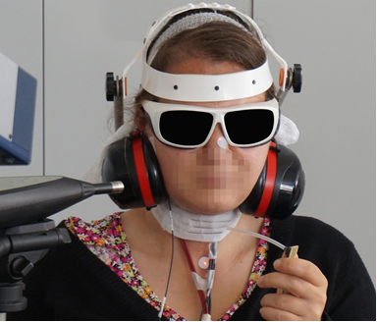
MEASUREMENT SET UP
Experiment arrangement during a participant’s phonation [pa:], [pi:] and [pu:]
Measurement of voice sound by microphone outside and by air pressure in mouth using the pressure sensor connected with the oral cavity by a compliant plastic tube with inner diameter of about 1.5 mm.
The subject was keeping the lips firmly sealed around the tube at the corner of the mouth to measure oral pressure fluctuation and during the production of voiceless plosive [p] was giving an estimate of subglottic pressure Psub.

Slide 6
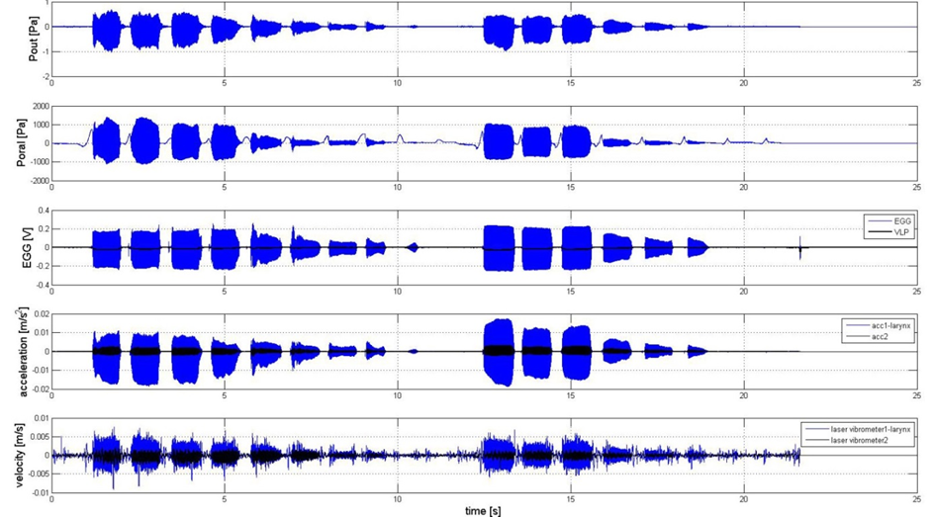
Example of uttering diminuendo on /pu: pu:/,
all time signals are recorded during one complete trial
Phonation diminuendo for /pu: pu:/, first in non-resonant voice and then in resonant voice. Signals from top: microphone signal, Poral, EGG and VLP signals (blue and black, respectively), accelerometric signals (ACC1 and ACC2) and laser vibrometric signals (LV1 and LV2) (for the latter two signals: blue line: registration from the larynx, black line: registration from the face).

Slide 7
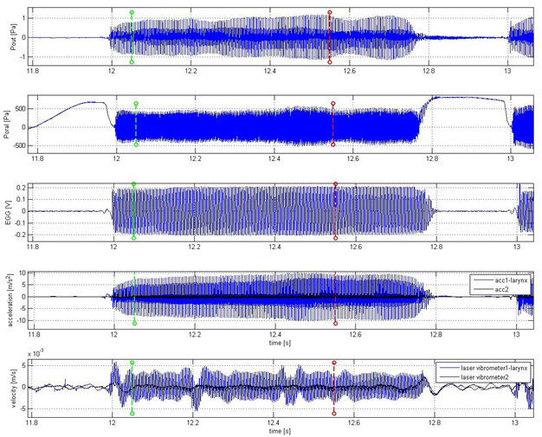
Example of recorded time signals for one trial uttering /pa:/
From top: microphone signal, Poral signal, EGG and VLP (vertical position of the larynx) signals (blue and black, respectively), two accelerometers and laser vibrometers signals (blue lines: registration from the larynx, black line: registration from the face).

Slide 8
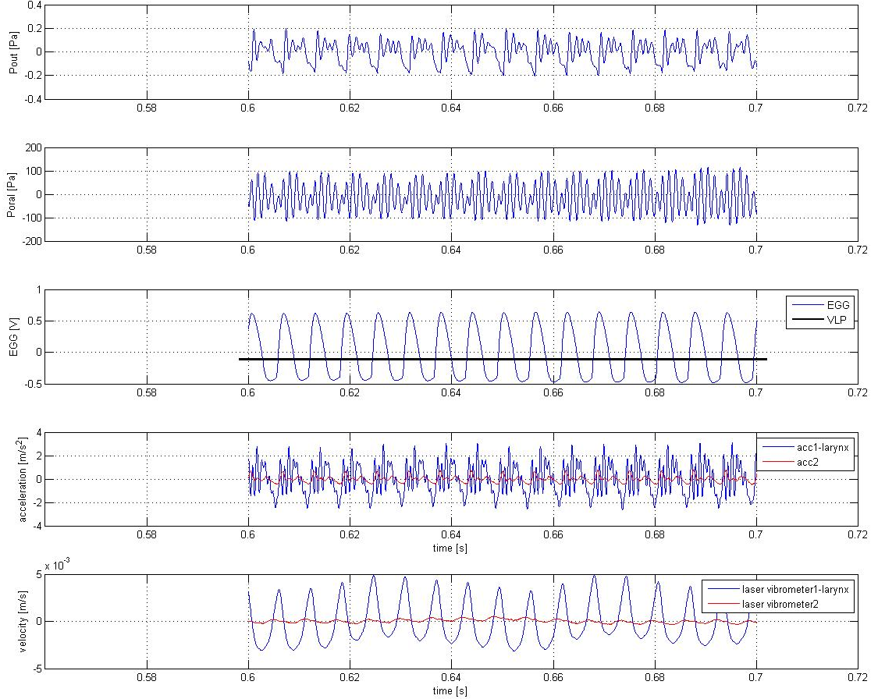
Evaluated part of recorded time signals for uttering /pa:/
Example of the chosen part of the signals for evaluation of the SPL and RMS values from microphone signal, Poral signal, EGG and VLP (vertical position of the larynx) signals (blue and black, respectively), two accelerometers and laser vibrometers signals (blue lines: registration from the larynx, red lines: registration from the face).

Slide 9
Evaluated structural displacements for /pa:/
Estimation of structural displacements (marked by green lines) in time domain obtained by integration from velocities of the skin measured by the laser vibrometers: 1/ LV1 on larynx (marked in subpicture by Ivib1) and 2/ LV2 on nose (marked by Ivib2), and from the accelerometers: 1/ ACC1 on larynx (marked in subpicture by Iacc1) and 2/ ACC2 on nose (marked by Iacc2) . This measurement was for resonant phonation on [pa:] by female 1 using the fundamental frequency ca =160 Hz and subglottic pressure Psub=115 Pa.

Slide 10
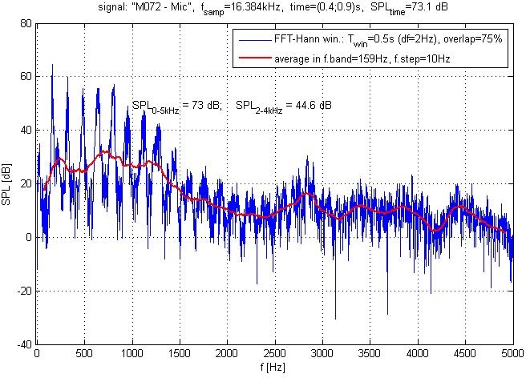
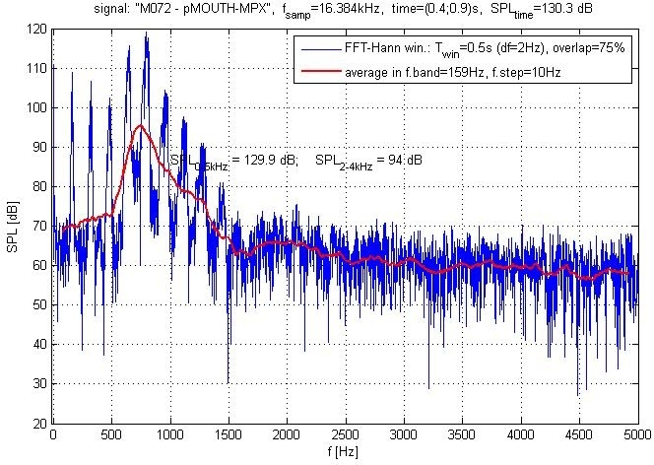
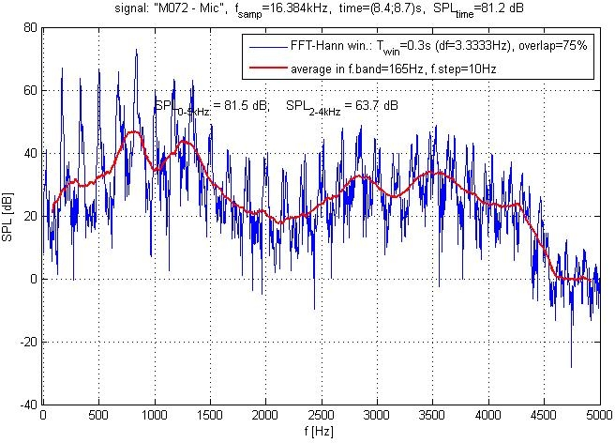
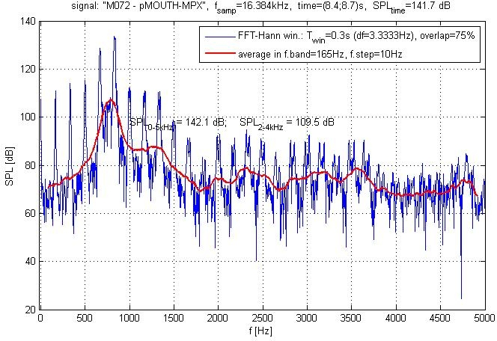
SPL measured by microphone and in mouth
resonant
f0=160 Hz
Psub=115 Pa
non-resonant
f0=165 Hz
Psub=260 Pa
microphone oral cavity
SPL (sound pressure levels) measured by external microphone 13 cm from the lips and in oral cavity. Measurement by female 1 for resonant and non-resonant phonation [pa:].

Slide 11
Spectra of structural skin displacements levels (SDL)
resonant
f0=160 Hz
Psub=115 Pa
Spectra were measured by laser vibrometers LV1 near larynx (marked by vib1 in first row left) and LV2 on nose (marked in first row by vib2 right) and by accelerometers ACC1 placed on larynx (marked by acc1 in lower row left) and by ACC2 placed near the ear (marked by acc2 in lower row right). Measurement is presented for resonant phonation [pa:] by female 1.

Slide 12
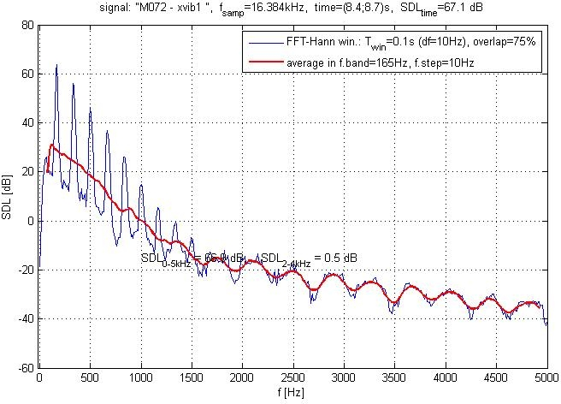
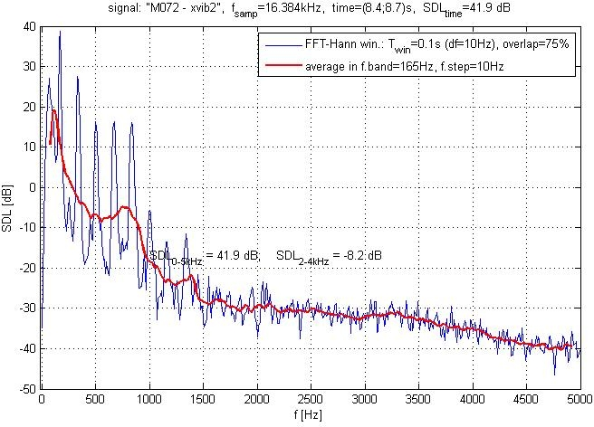
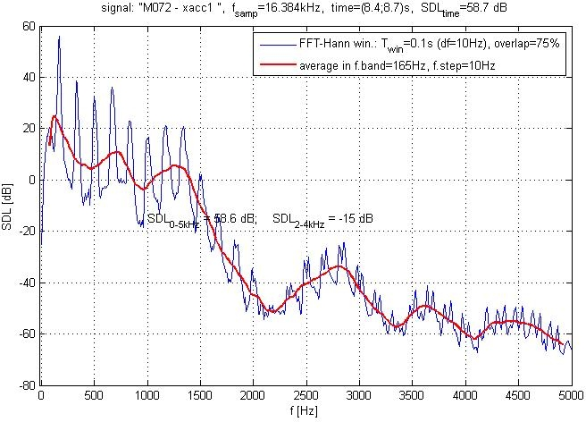
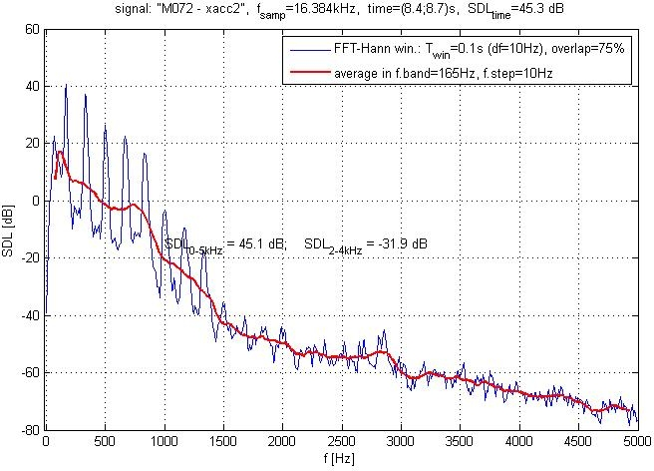
Spectra of structural skin displacements levels (SDL)
non-resonant
f0=165 Hz
Psub=260 Pa
Spectra were measured by laser vibrometers LV1 near larynx (marked by vib1 in first row left) and LV2 on nose (marked in first row by vib2 right) and by accelerometers ACC1 placed on larynx (marked by acc1 in lower row left) and by ACC2 placed near the ear (marked by acc2 in lower row right). Measurement is presented for resonant phonation [pa:] by female 1.

Slide 13
Comparison of resonant and non-resonant phonation data for vowel [a:]
Female 1
Displacements computed from time signals (M109): | VIB1 larynx | VIB2 nose | ACC1 larynx | ACC2 ear
RMS displacement [µm] average for resonant voice | 1.300 | 0.165 | 0.815 | 0.122
RMS displacements [µm] average for non- resonant voice | 1.270 | 0.265 | 0.633 | 0.150
Data resulted from spectra SDL [dB] of displacements
L₁ [dB] resonant | 60.3 | 40.9 | 55.6 | 38.7
L₁ /dB/ non- resonant | 58.9 | 44.5 | 52.7 | 40.1
F1 [Hz] resonant | / | 640 | 697 | 620
F1 [Hz] non-resonant | / | / | 720 | /
F2 [Hz] resonant | / | 1140 | 1228 | 1225
F2 [Hz] non-resonant | / | / | 1244 | 1400
i
Female 2
Displacements computed from time signals (M072): | VIB1 larynx | VIB2 nose | ACC1 larynx | ACC2 ear
RMS displacement [µm] average for resonant voice | 2.09 | 0.14 | 0.61 | 0.13
RMS displacements [µm] average for non- resonant voice | 2.09 | 0.10 | 0.72 | 0.15
Data resulted from spectra SDL [dB] of displacements
L₁ [dB] resonant | 61.8 | 38.1 | 50.9 | 36.5
L₁ /dB/ non- resonant | 62.8 | 35.6 | 54.5 | 38.6
F1 [Hz] resonant | / | 590 | 650 | 600
F1 [Hz] non-resonant | / | 750 | 750 | 750
F2 [Hz] resonant | / | / | 1170 | /
F2 [Hz] non-resonant | / | 1400 | 1250 | /

Slide 14
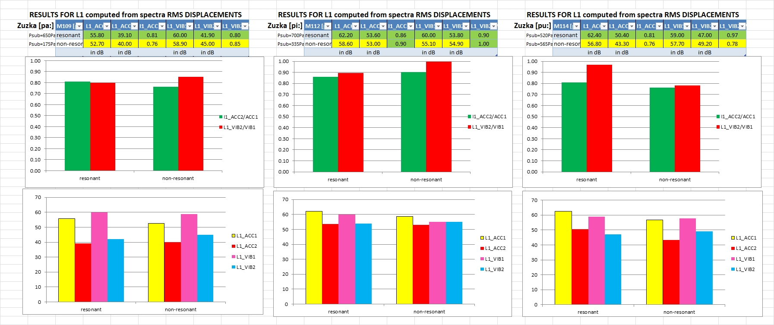

Slide 15
Conclusions
Rather than corresponding to the previously measured mechanical (vibrational) resonances of the human head, the facial vibrations appear to correlate with the acoustic pressure oscillations in the mouth, corresponding to L1 level at the first harmonic frequency f₀ of the voice.
The measured facial vibrations on human skin are forcedly excited by acoustic pressure fluctuations.
The resonant voice shows lowering the first two formant frequencies F1, F2 closer to the frequency f₀. This effect can be attributed to prolongation of the vocal tract.
The RMS displacements and the level of the first harmonic show contradicting results at the larynx, nose and ear for the resonant versus non-resonant phonations in these pilot data.
We plan these to be readdressed in future investigations.

Slide 16
References
Barrichelo-Lindström,V. and Behlau, M. (2009) Resonant voice in acting students: perceptual and acoustic correlates of the trained y-buzz by Lessac. Journal of Voice, 23, 5, pp. 603-609.
Håkansson, B., Brandt, A., Carlsson, P. and Tjellström, A. (1994) Resonance frequencies of the human skull in vivo. The Journal of the Acoustical Society of America, 95, 3, pp. 1474-1481.
Horáček, J., Veselý, J., Pešek, L. and Vohradník, M. (2004) Fundamental dynamic characteristics of human skull. Engineering Mechanics, 11, 2, pp. 139 –158.
Kirikae, J., Sato, T., Oshima, H. and Nomoto, K. (1964) Vibration of the body during phonation of vowels. Rev. de Laryngologie, Otologie, Rhinologie 85, pp. 317-345.
Smith, CG., Finnegan, EM. and Karnell, MP. (2005) Resonant voice: spectral and nasoendoscopic analysis. Journal of Voice, 19, 4, pp. 607–622.
Sundberg, J. (2022) Objective characterization of phonation type using amplitude of flow glottogram pulse and of voice source fundamental. Journal of Voice 36, 1, pp. 4-14.
Verdolini, K., Druker, DG., Palmer, PM. and Samawi, H. (1998) Laryngeal adduction in resonant voice. Journal of Voice 12, 3, pp. 315-327.
Zhang, Z. (2020) Laryngeal strategies to minimize vocal fold contact pressure and their effect on voice production. J Acoust Soc Am, 148, 2, pp. 1039–1050.

